Slide 1




U.S. Food and Drug Administration (FDA) SQL PROJECT
Submitted by: Kapil Kr. Nirwan

Slide 2

01
Introduction

Slide 3
Contents of this template
Table 1. | Visualize the yearly approval trends of drugs. Highlight any significant patterns and/or fluctuations, if any.
Table 2. | Explore approval trends over the years based on different sponsors. Uncover patterns and changes in approval rates among sponsors.
Table 3. | Visualize the segmentation of products based on Marketing Status.
Table 4. | Show the total number of applications for each Marketing Status. Enable users to filter by years and Marketing Status for detailed analysis.
Table 5. | Analyze the grouping of drugs by dosage form. Visualize the distribution of approvals across different forms. Identify the most successful dosage form.
Table 6. | Visualize drug approvals based on therapeutic classes. Identify classes with the highest number of approvals.

Slide 4
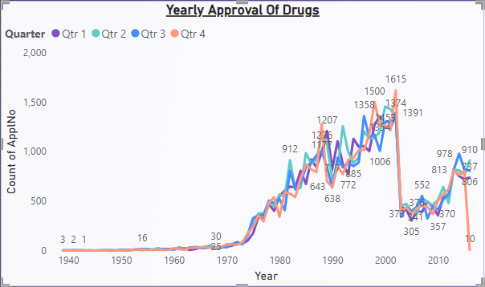
1. Yearly Approval Of Drugs
Year App No.
289 Application numbers are starting getting higher
4452 Application numbers is at peak on 90,s
2826 In 1990 we can see a clear drop in App.No
5736 In 2002 Application numbers are again in peak
1624 In 2003 we can see a drastic drop down

Slide 5
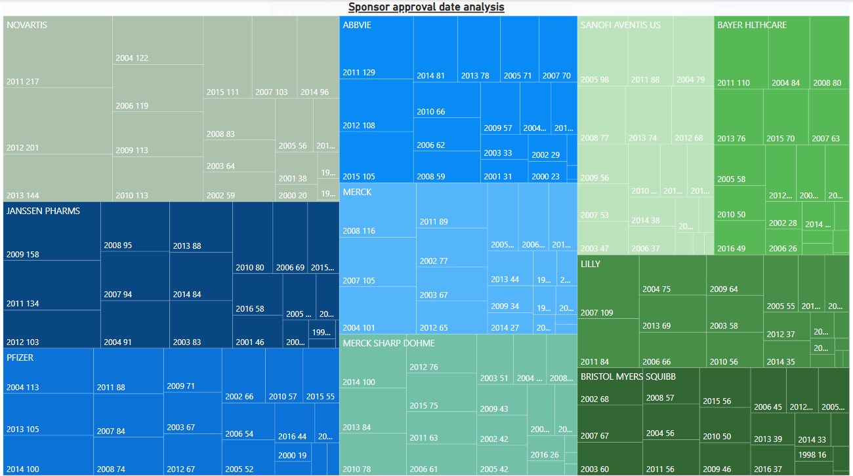
2. Sponsor Date Analysis
In this analysis I have used Tree Map chart in which we can clearly Top 10 approval trends over the years based on different sponsors

Slide 6
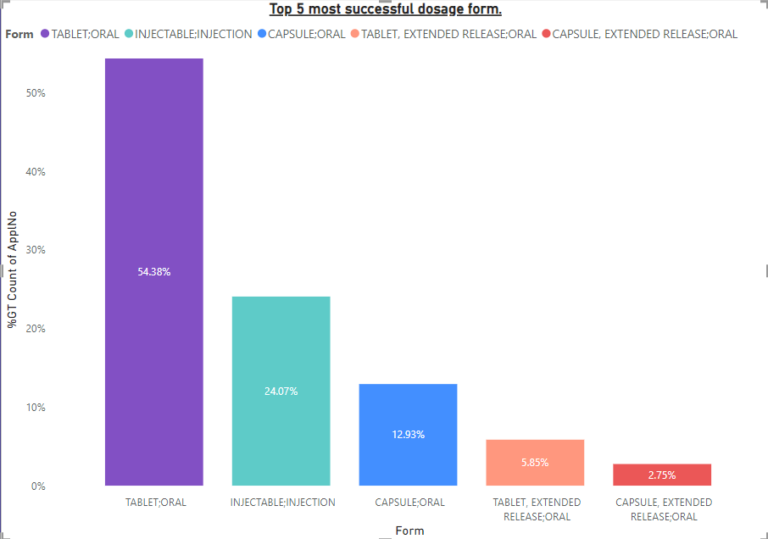
3. Top 5 most successful dosage form.
Top 5 most successful dosage form.
Tablet is at 54.38%
Injectables;Injection is at 24.07%
Capsule;oral is at 12.93%
Tablet,ExtendedRelease;oral is at 5.85%
Capsule,Extended release;oral is at 2.75%

Slide 7
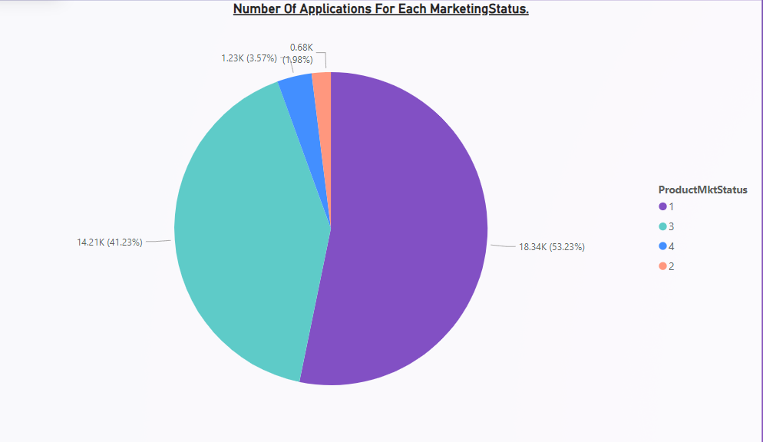
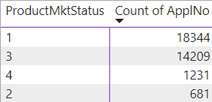
4. Number of applications for each Marketing status.

Slide 8
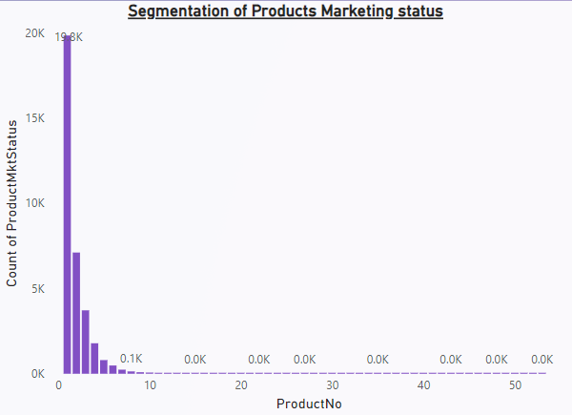
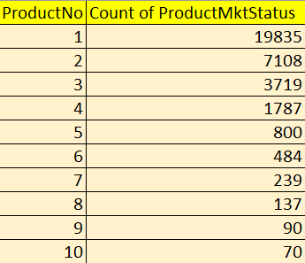
5. Segmentation on Marketing status
This chart show the total number of applications for each Marketing Status.

Slide 9
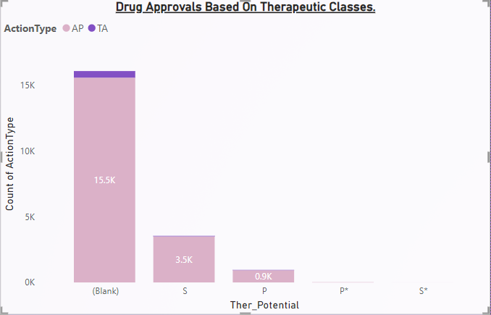
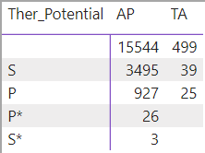
6. Drug Approvals Based On Therapeutic Classes.
This chart Visualize overall drug approvals based on therapeutic classes and Identify classes with the highest number of approvals.

Slide 10
Thank you

